Slide 1

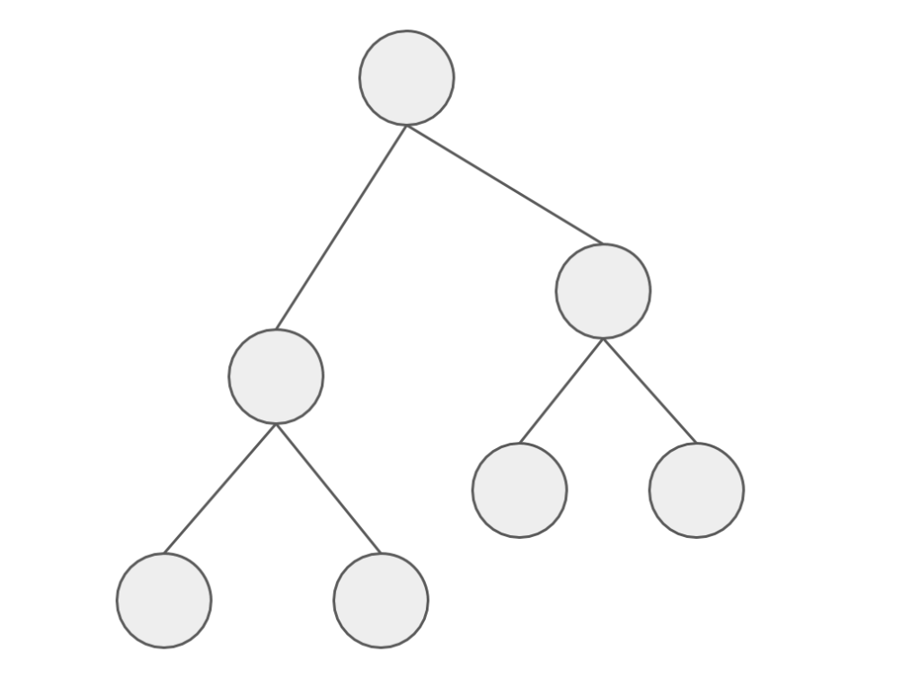
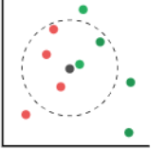
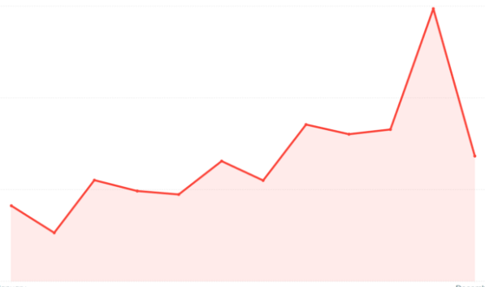
Price Predictor Regression Models
Random Forest
LGBM
KNN
Facebook Prophet
Notes:
To predict prices, we decided to use the Random Forest & LGBM Regressor methods to determine which features are the most important to price an AirBNB.
We then use the KNN Regressor to see how the price is affected with having listings close to your area.
Finally, we used the Facebook Prophet to how prices are affected by time & seasonality to predict Airbnb future prices.

Slide 2
Model Data Cleaning – Adding Columns
How will this new feature will impact the price?
amenities
[“Wifi”, “Kitchen”, “Heating”, “Air Conditioning]
amenities_count
4
Notes:
Before we actually run the model, we have to clean the database by adding certain information that may add value to our findings.
So we added the amenities count column because we believe that it has a positive correlation to the listing price.

Slide 3
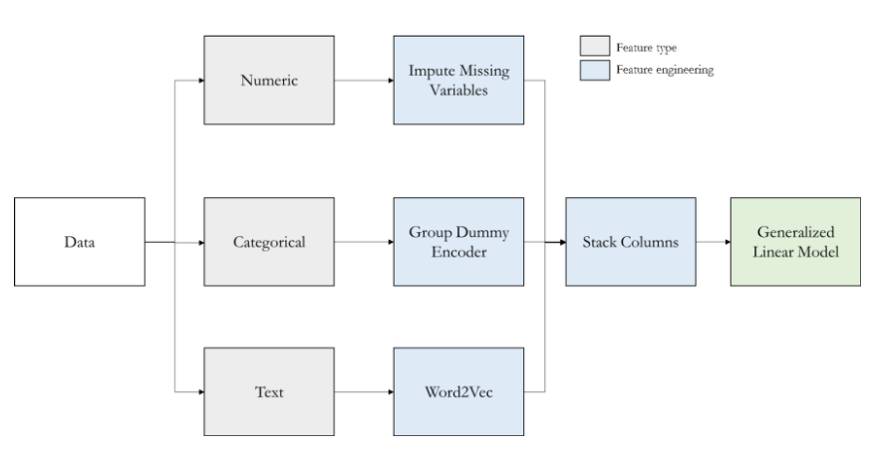
Model Data Transformation - Regressor
Note: Used for Random Forest, LGBM and KNN Regressor Models only
Notes:
This table provides an overview of what we need to do to try to find the best fit for the model. The next few slides will provide a breakdown of what we did to transform the data.

Slide 4
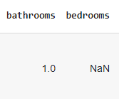


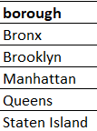
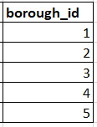

Model Data Transformation Methods
1. Imputing Missing Numerical Data
2. Encoding Categorical Data
3. Vectorizing Text Data
Notes:
First, we needed to replace the blank fields with the averages for that specific column
Second, we need to put the data by categories

Slide 5
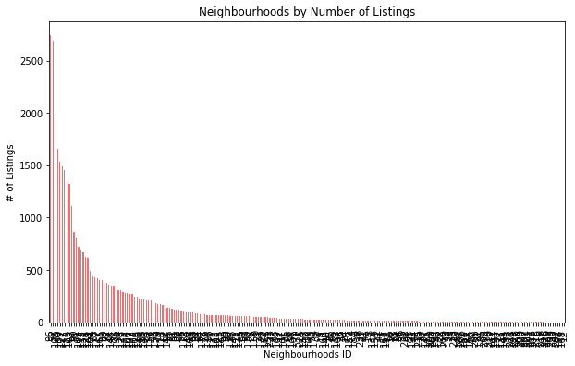
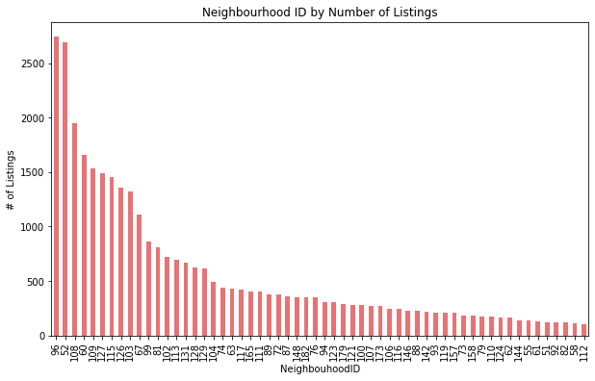
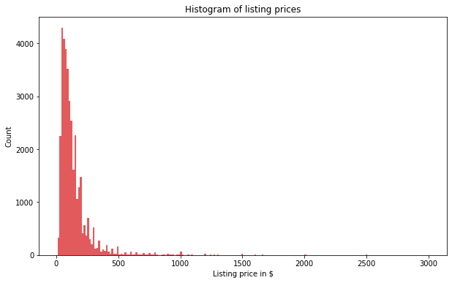
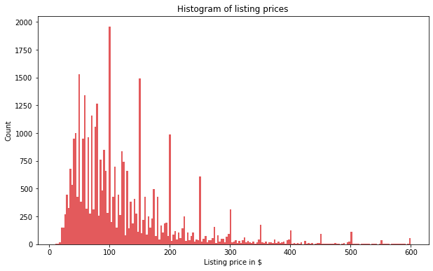
Model Data Transformation Methods
4. Removing Outliers
Filter for:
1. ≥100 Listings
2. ≤ $600/night
Notes:
We filtered out major outliers to get the best selection of listings that best represents NYC Airbnb market.
We filtered out the outliers by only keeping the neighbourhoods that with over 100 listings & the listing prices under $600 so it is more normally distributed.

Slide 6
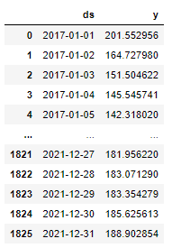
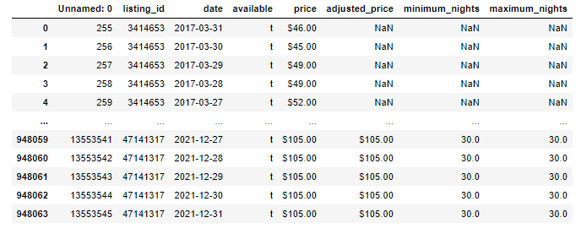

Model Data Transformation Methods
5. Create New Datasets for the Prophet Model
2017-2021 Average Rates
Final Output for Prophet Model
Filter
Format
Calculate
Rename
6. Create New Holiday Dataset for the Prophet Model
Notes:
Also, we had to create another dataset for FB prophet as the model runs differently from the other regressor model.
Filter for date and price columns
Format the date to datetime and price to float
Calculate the daily average for the price
Rename the date column to ds and price to y

Slide 7
Model Data Transformation Methods
6. Create Price Predictor Model by Borough and Room Type
Notes:
Also, we had to create another dataset for FB prophet as the model runs differently from the other regressor model.
Filter for date and price columns
Format the date to datetime and price to float
Calculate the daily average for the price
Rename the date column to ds and price to y

Slide 8
Model Feature Selection
X-value of features listed below that may have the most impact y-value of the listing price:
Neighbourhood
Host Identity Verified
Host Listing Counts
Super Host Listings
Room Type
Number of People that the Listing can Accommodate
Number of Amenities Provided
Number of Bathrooms
Number of Bedrooms
Number of Beds
Amenities like Heating, Parking Dryer, Daily Essentials, Kitchen etc
Minimum Nights to be Booked
Number of Reviews
Review Score Ratings
Notes:
We have collectively gone through the feature selection process to determine which features we feel that will have the most impact on the listing price.

Slide 9
Model Train-Test Split & Preprocessing
Change test data from 25% to 35% to provide more data to increase accuracy of the models.
Scale the X-values for normalizations to ensure all features are the same unit.
Notes:
We changed the default settings of the test data from 25% to 35% so that will have more data to give a more realistic results of predicting prices.
We need to scale the data to the same units so differences won’t be distorted. If this is not done, the test results will have major fluctuations.

Slide 10
Running the Model
Change test data from 25% to 35% to provide more data to increase accuracy of the models.
Scale the X-values for normalizations to ensure all features are the same unit.
Notes:
We changed the default settings of the test data from 25% to 35% so that will have more data to give a more realistic results of predicting prices.
We need to scale the data to the same units so differences won’t be distorted. If this is not done, the test results will have major fluctuations.

Slide 11
Running the model
Notes:
-To help users explore all listings available in NYC, we created a marker cluster map using Leaflet.
-The clusters display the number of listings with the different boroughs and neighbourhoods in NYC.
-In this example, we selected the the well-known New York borough of Manhattan, and then further zoomed in to the Upper West Side neighbourhood.

Slide 12
Model Challenges
Notes:
-To help users explore all listings available in NYC, we created a marker cluster map using Leaflet.
-The clusters display the number of listings with the different boroughs and neighbourhoods in NYC.
-In this example, we selected the the well-known New York borough of Manhattan, and then further zoomed in to the Upper West Side neighbourhood.

Slide 13
Model Findings – Price Correlation
Notes:
-To help users explore all listings available in NYC, we created a marker cluster map using Leaflet.
-The clusters display the number of listings with the different boroughs and neighbourhoods in NYC.
-In this example, we selected the the well-known New York borough of Manhattan, and then further zoomed in to the Upper West Side neighbourhood.

Slide 14
Model Findings – Features
Notes:
-To help users explore all listings available in NYC, we created a marker cluster map using Leaflet.
-The clusters display the number of listings with the different boroughs and neighbourhoods in NYC.
-In this example, we selected the the well-known New York borough of Manhattan, and then further zoomed in to the Upper West Side neighbourhood.

Slide 15
Model Findings – Nearest Neighbour
Notes:
-To help users explore all listings available in NYC, we created a marker cluster map using Leaflet.
-The clusters display the number of listings with the different boroughs and neighbourhoods in NYC.
-In this example, we selected the the well-known New York borough of Manhattan, and then further zoomed in to the Upper West Side neighbourhood.

Slide 16
Model Findings – Trends & Seasonality
Notes:
-To help users explore all listings available in NYC, we created a marker cluster map using Leaflet.
-The clusters display the number of listings with the different boroughs and neighbourhoods in NYC.
-In this example, we selected the the well-known New York borough of Manhattan, and then further zoomed in to the Upper West Side neighbourhood.

Slide 17
Results
Notes:
-To help users explore all listings available in NYC, we created a marker cluster map using Leaflet.
-The clusters display the number of listings with the different boroughs and neighbourhoods in NYC.
-In this example, we selected the the well-known New York borough of Manhattan, and then further zoomed in to the Upper West Side neighbourhood.

Slide 18
Next Steps…
A major area of concern for cities worldwide is the effect that expansion of Airbnb has made on the housing market for indigenous residents.
Further analysis can help determine if there is a correlation between Airbnb listings and rental/house prices for NYC neighbourhoods.

